Slide 1





Humm Group Oy: Financial Analysis and AI Implementation Potential
Business Focus
Customer Experience Consulting & Outsourcing
Location
Jyväskylä, Finland
Employees
52
A comprehensive analysis of Humm Group Oy's financial performance and evaluation of AI implementation opportunities
Revenue (2024)
€2.1 million
Financial Analysis Report | September 2025

Slide 2






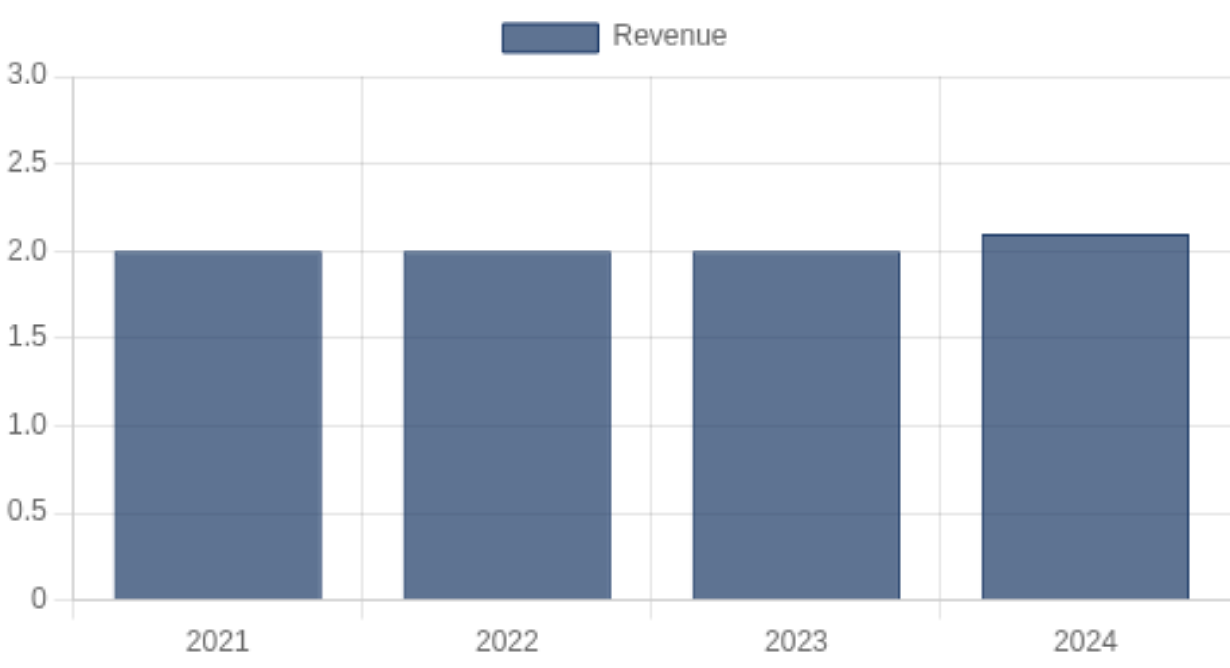
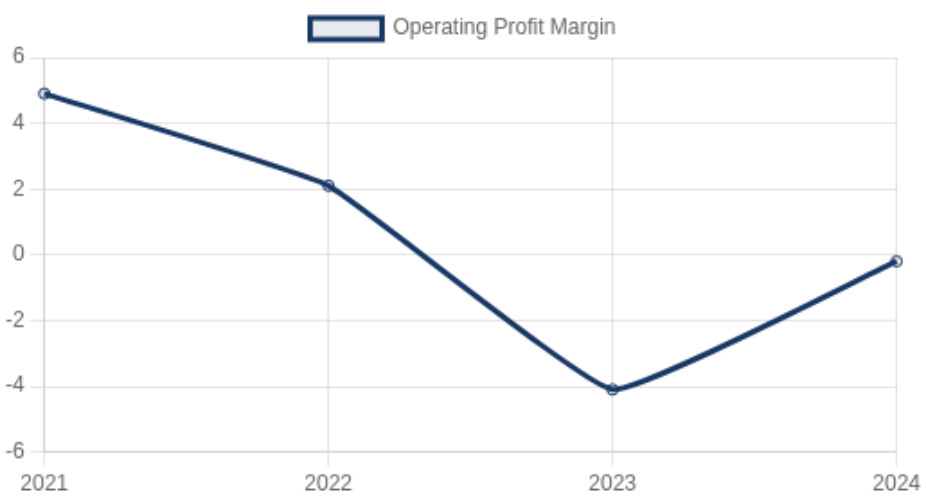
Financial Analysis of Humm Group Oy
Key financial metrics and performance trends
Revenue (2024)
Operating Profit (2024)
Operating Profit Margin
Employees
€2.1M
-€4,870
-0.2%
52
-7.7% from previous year
Improved from -€94,816
Improved from -4.1%
-2 from previous year
Revenue Trend (€ millions)
Profit Margin Trend (%)
Financial Analysis Report | September 2025

Slide 3
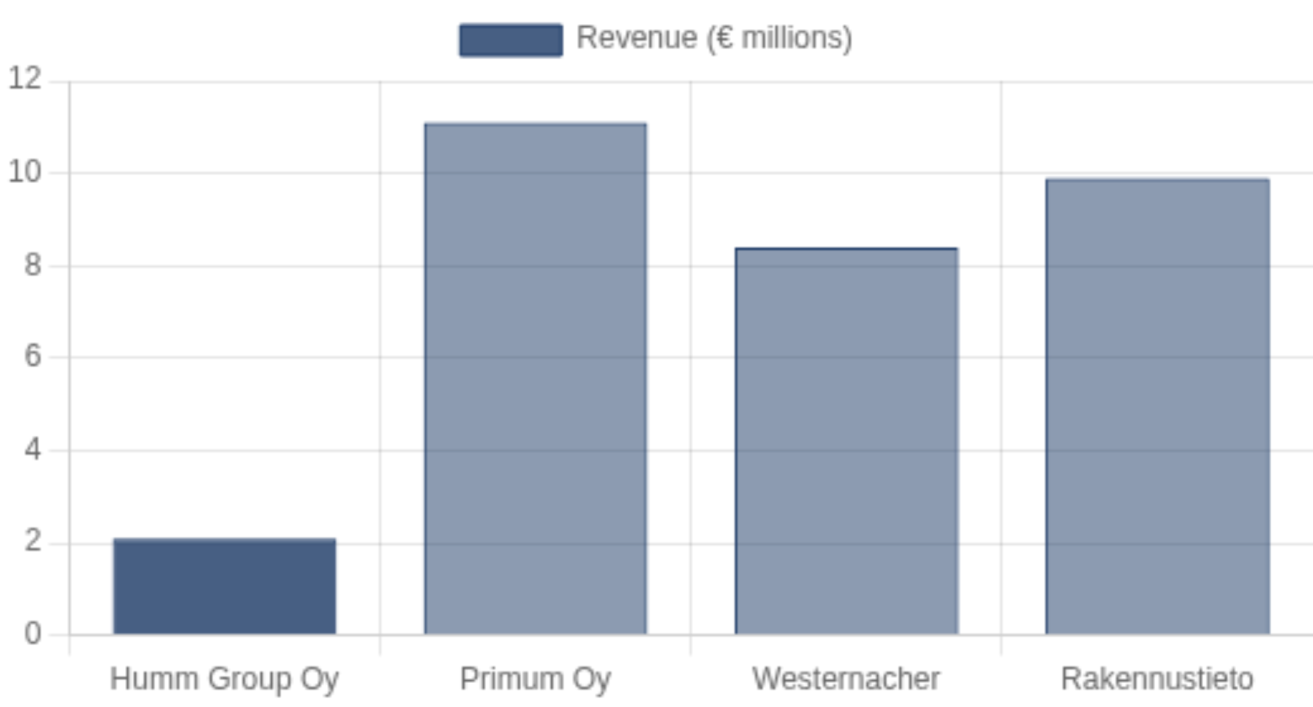
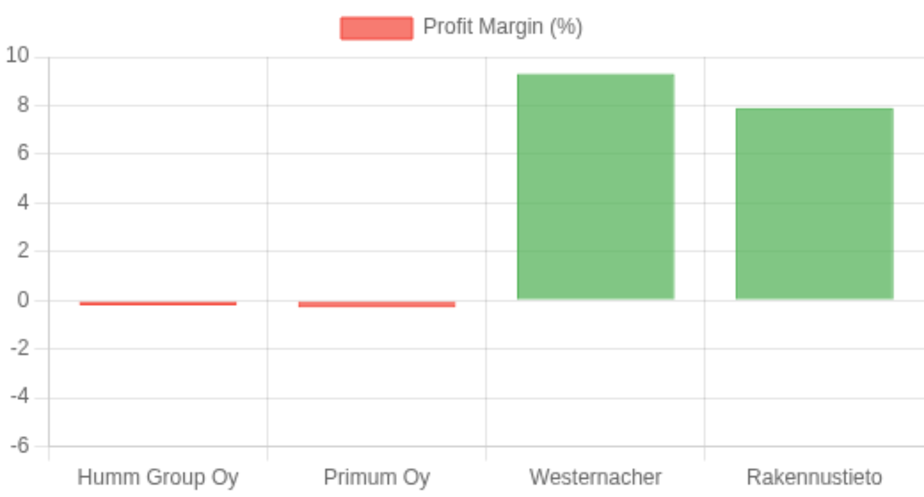
Company Comparison
Benchmarking Humm Group Oy against similar Finnish companies
Revenue Comparison (€ millions)
Profit Margin Comparison (%)
Financial Analysis Report | September 2025

Slide 4
















Humm Group Oy's AI Initiatives and Strategy
Current AI projects and implementation approach
Current AI Projects
AI Talent & Recruitment
Virtual Assistant with 50% resolution rate
Active hiring for Technology Lead position
AI-powered customer service solutions
Focus on AI transformation initiatives
ChatGPT integration for customer support
Testing new AI and automation solutions
Reduced call handling time through AI
Building team for "big changes around AI"
Thought Leadership
Implementation Strategy
Blog posts on AI and ChatGPT in working life
Focus on customer experience enhancement
Public discussions on AI applications
Identifying bottlenecks and improving efficiency
Exploring AI technology development trends
Collaborative development with partners
Testing and scaling successful AI solutions
"Tekoäly ja ChatGPT osana (työ)elämää – Mistä on kyse?"
- Humm Group Oy Blog
Financial Analysis Report | September 2025

Slide 5
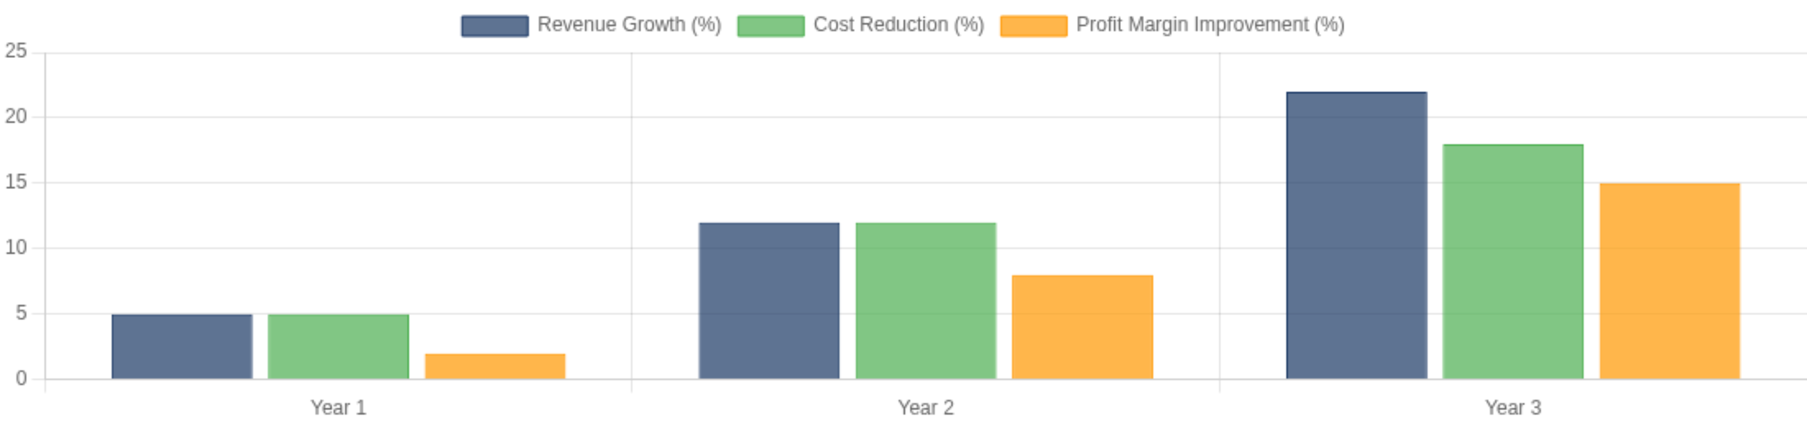













Potential Impact of AI Implementation
Projected improvements in performance and competitive position
Projected Financial Impact Over 3 Years
Operational Efficiency
Customer Experience
Process automation
24/7 AI-powered support
Reduced response time
Personalized interactions
Optimized resource allocation
Proactive service
+25-30% efficiency gain
+35-40% satisfaction
Cost Reduction
Revenue Growth
Lower customer service costs
New AI service offerings
Reduced manual work
Improved customer retention
Better resource planning
Competitive differentiation
15-20% cost savings
+20-25% revenue growth
Financial Analysis Report | September 2025

Slide 6














Recommendations for AI Implementation
Strategic action steps and investment priorities
Strategic Priorities
Action Steps
Focus on customer experience AI solutions
Hire Technology Lead and AI specialists
Develop proprietary AI capabilities
Launch AI pilot projects in Q1 2026
Integrate AI with existing service offerings
Develop AI service offering portfolio
Invest in employee AI training
Position as AI customer experience leader
Investment Focus
Growth Strategy
AI development team expansion
Develop new AI-powered service lines
Cloud infrastructure for AI services
Target larger enterprise clients
Data management and analytics
Expand to Nordic markets by 2027
Strategic AI partnerships
Achieve industry-leading profit margins
AI Implementation Timeline
1
2
3
Foundation
Development
Scale
Q1-Q2 2026: Team building, infrastructure setup, pilot projects
Q3-Q4 2026: Service development, market testing, refinement
2027: Full market launch, expansion, growth optimization
Financial Analysis Report | September 2025

